Slide 1
SAS Infographics Team 3
Sushil Ganesh
Shraddha Naik
Sayali Mirajkar
Prashant Gupta

Slide 2
Goals
With our prototype we aim to enable our users tell better stories through the infographics they present.
Our main focus would be to develop a tool that would make the creation of dynamic infographics as easy as doodling on a canvas.
We also hope that our design model would facilitate the designers to create a viewing experience that is not only aesthetically pleasing but also interactive and fun for the end users.

Slide 3
What are infographics?
Graphic visual representations of information, data or knowledge intended to present complex information quickly and clearly(Wikipedia)
Used to integrate a variety of information, such as the conceptual layout of the transit network, transfer points, and local landmarks for faster interpretation
Used when we need to explain data in a visually appealing way

Slide 4
Infographics vs Visualizations
Tend to be specific to a topic or cause | Tend to be general
Context-sensitive | Context-free
Mostly hand-crafted | Mostly automatic
Take time to create | Can be generated quickly
Source: https://eagereyes.org/blog/2010/the-difference-between-infographics-and-visualization

Slide 5
Approach
Discovery
Prototype Designing
Implementation
Evaluation

Slide 6
Step 1: Discovery
Research topics on infographics.
Went through a few infographics tools online:
Static Infographics:
http://www.andrusia.com/AndrewUnitsChart.gif
http://info.executivesonline.co.uk/hs-fs/hub/469179/file-2472676340-png/Images/Infographics/The-True-Cost-Of-A-Bad-Hire.png
http://www.nationaljewish.org/NJH/media/img/stock/img-stock-cigarette-infographic.jpg
Dynamic Infographics:
http://www.evolutionoftheweb.com/
Onsite visit and functionality survey.

Slide 7
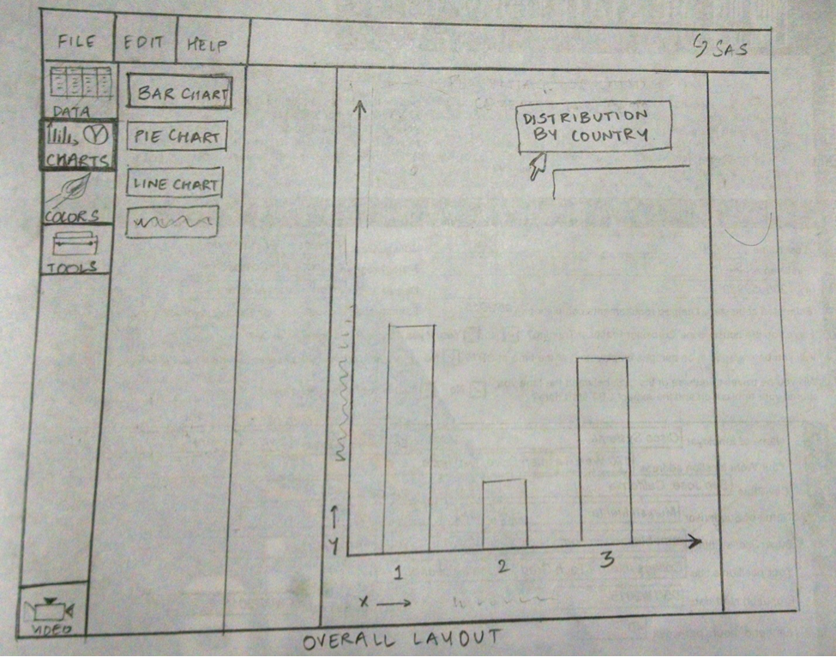
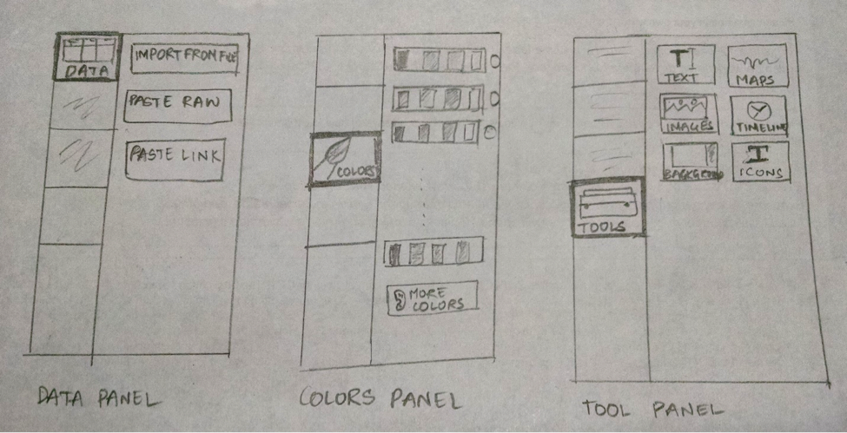
Step 2: Prototype designing
Early mockups:

Slide 8
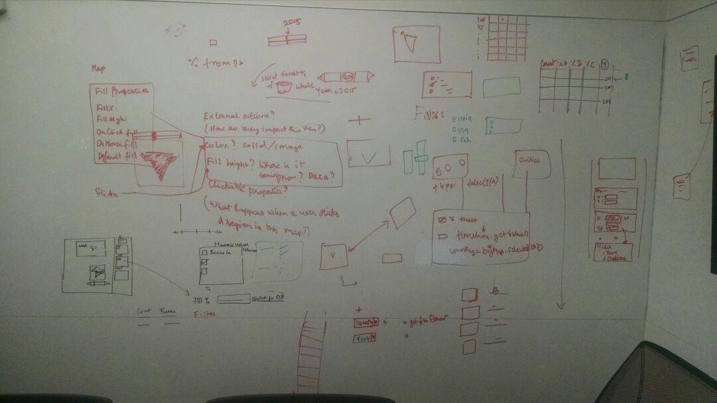
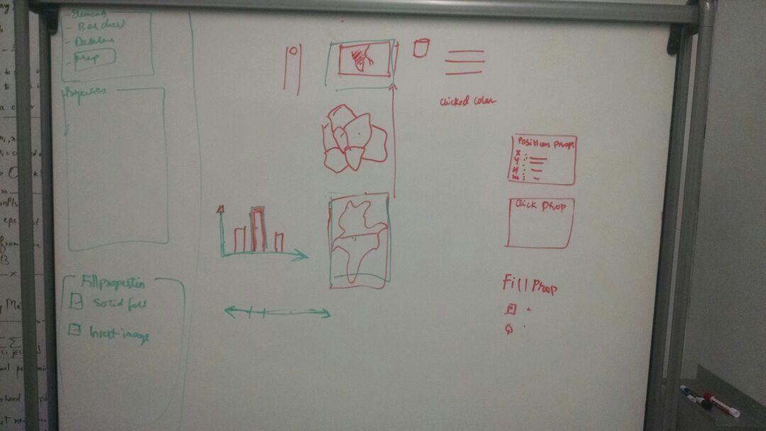
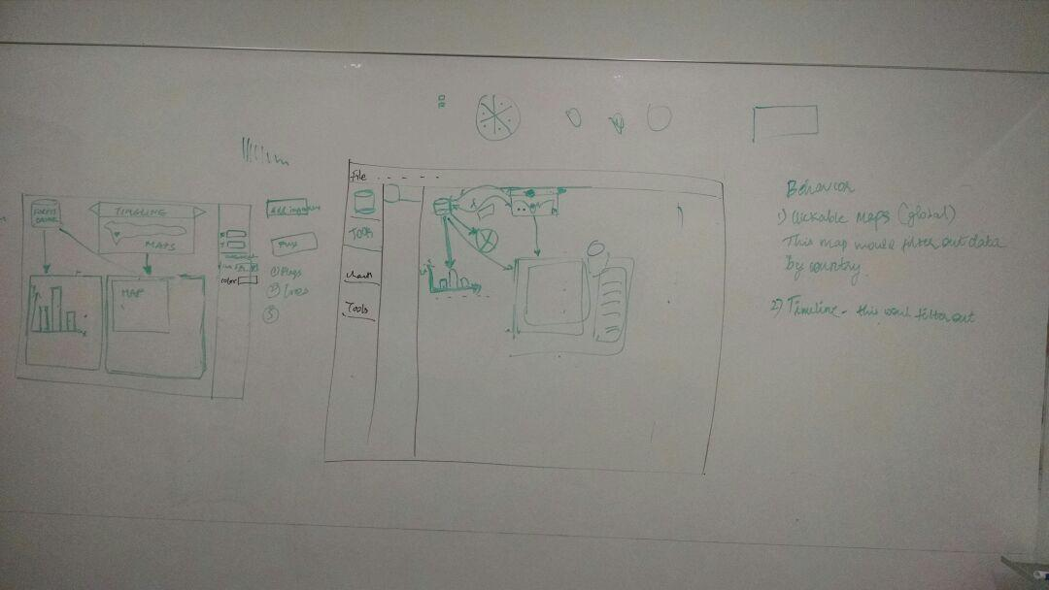
Brainstorming

Slide 9
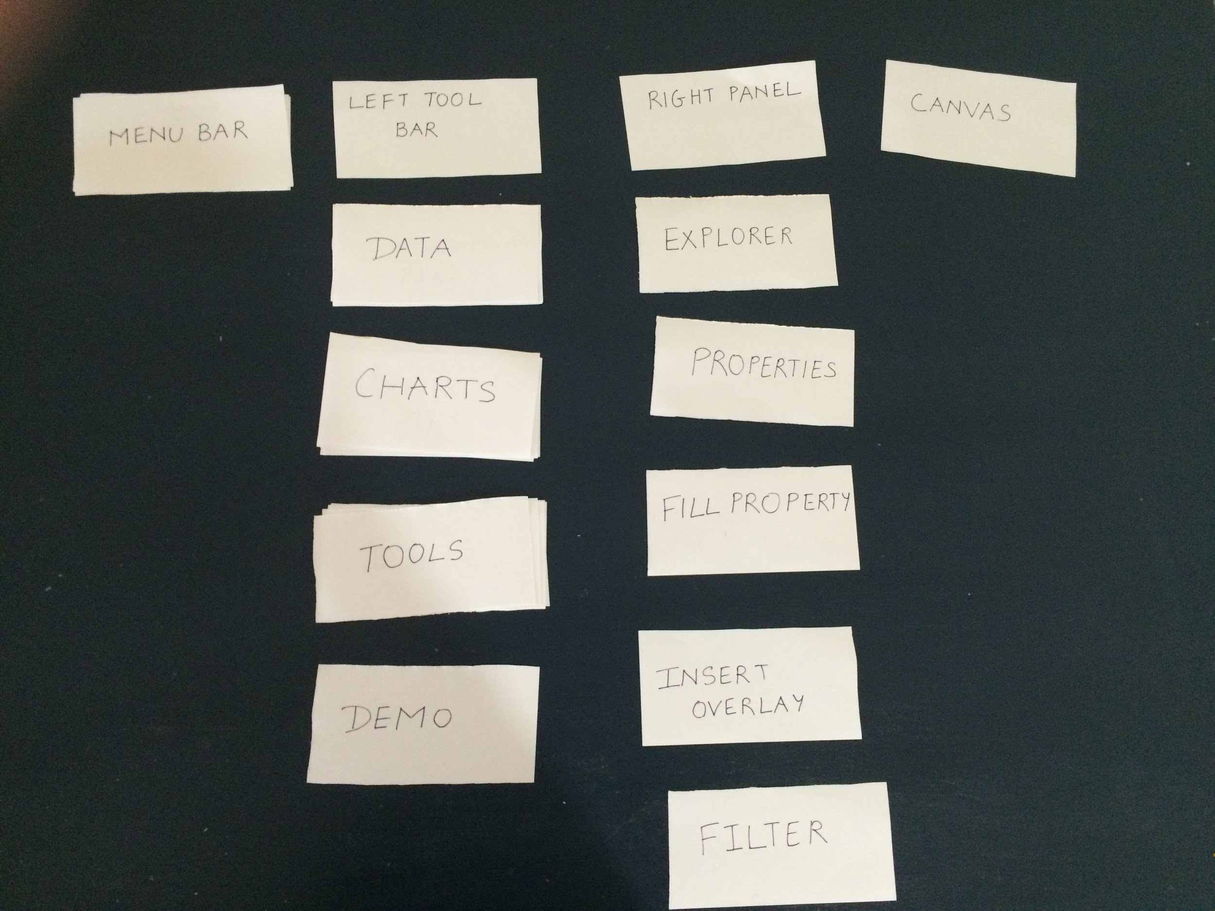
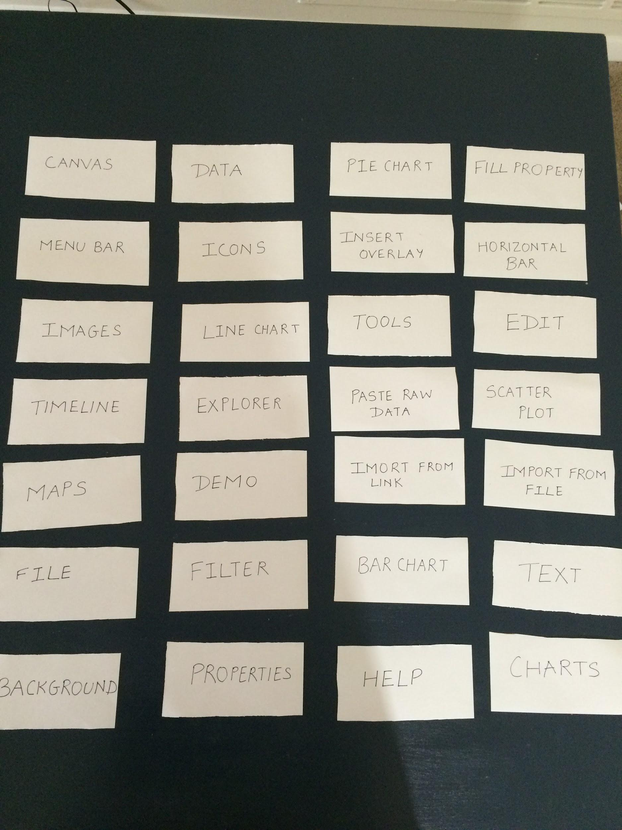
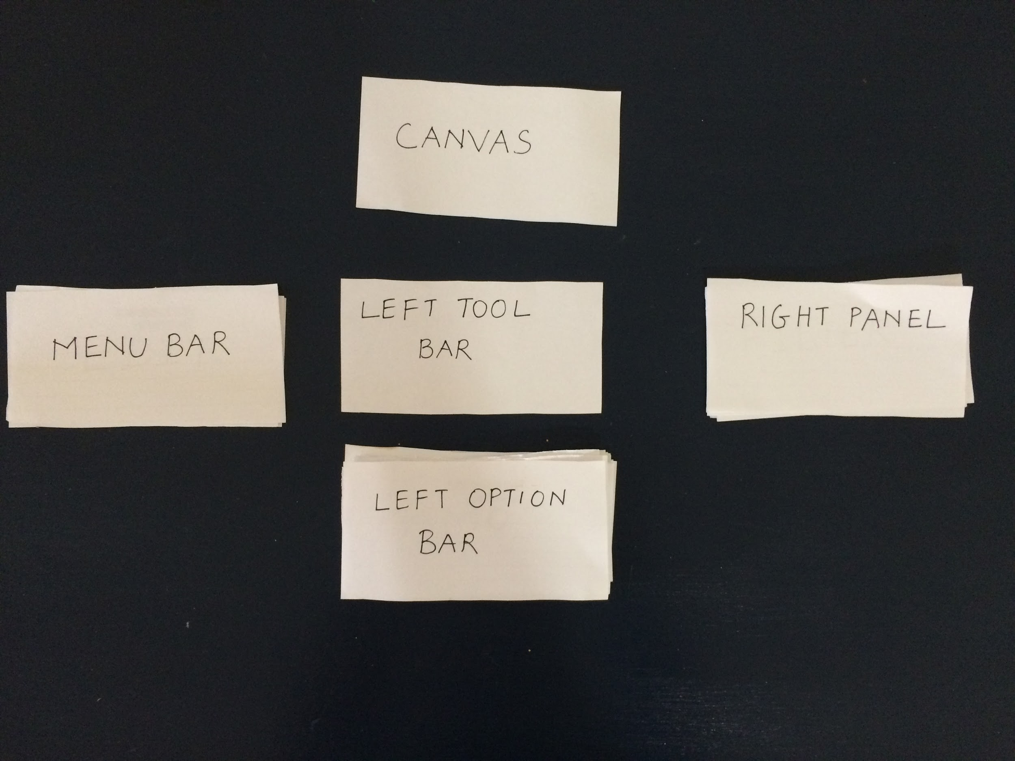
Card Sort
https://www.youtube.com/watch?v=4QLyoSRcmN8&feature=em-upload_owner#action=share

Slide 10
User Video
After interviewing a user we reconfirmed our Layout
We also incorporated his idea of selecting different bars of the graph and changing overlays.
He also suggested using clickable maps instead of drop downs..
He also suggested that using different timeline would make the canvas look clustered
Link: https://drive.google.com/open?id=0Bz-8qxCGldFCaW9YWUs2LVdvTXM&authuser=1

Slide 11
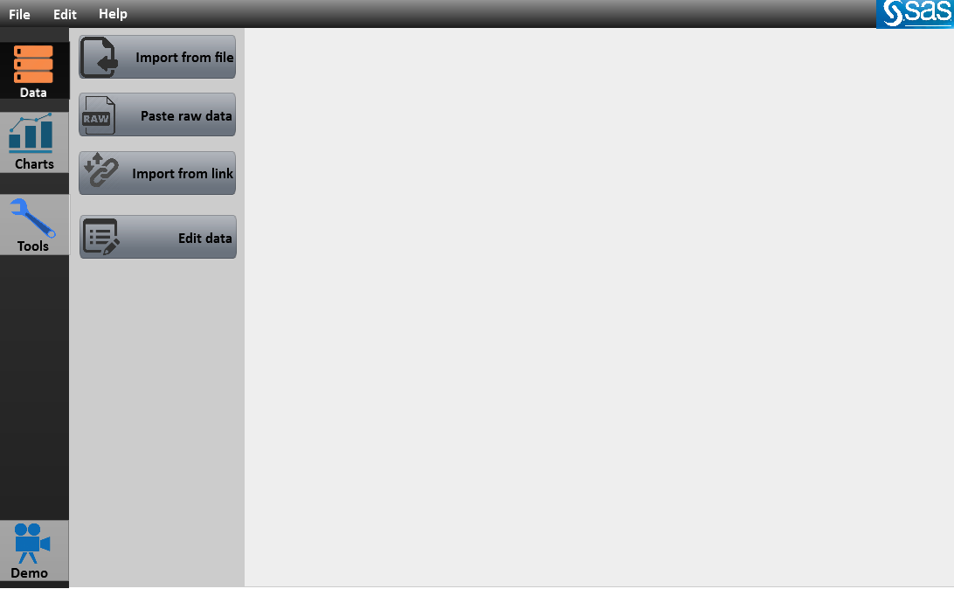
Layout

Slide 12
Step 3: Implementation
Tools used:
Pencil Project : For creating the layout.
Invision: Creating the flow of the prototype.
Jquery, HTML, CSS: For creating onclick Maps.
d3js: For creating map overlay using slider.

Slide 13
Functionalities
The are the functionalities which our tool supports:
Options to add image overlays on the bar graphs
Add a clickable world map to the canvas
Add custom filters to individual countries, and add them to the canvas as well
Adjust fill value for individual country based on data
Option to add image overlay on country
Add a timeline object, and change values of fill of countries based on temporal data.
Add text data on top of individual countries to depict the percentage fill.

Slide 14
Prototype
We have set up a working prototype of all the functionalities listed.
Link:http://invis.io/VT2WWHUE5
Output : http://invis.io/ES2WF6OF9

Slide 15
Step 4: Evaluation
We took help of various factors to make our project better:
Critiques
Analyzing and reworking on all points which we received in our critiques, and making sure we were in constant touch with our SAS counterparts.
User Testing
We gave the link to our prototype and provided the workflow steps to the users to try our tool.
Surveys
We created a survey about our project and distributed it across the class to receive feedback on what they liked or disliked and what we could improve upon.
Link to survey: http://goo.gl/forms/fZKJYzLtuw

Slide 16
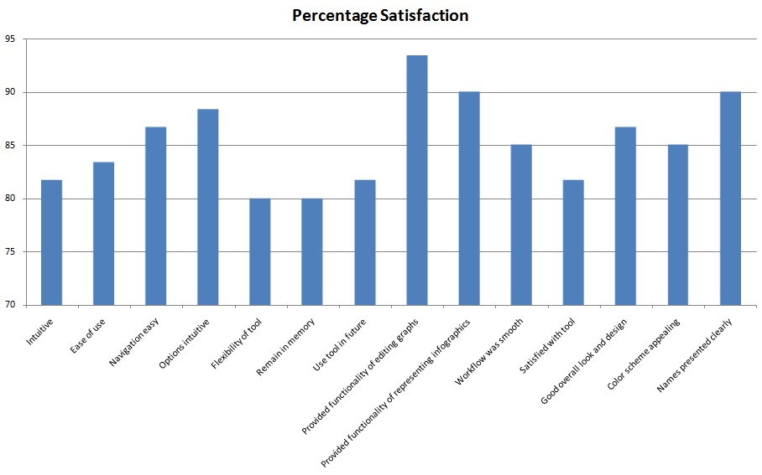
Results from Survey

Slide 17
Use Case Implementation
Using D3js and jQuery libraries we were able to demonstrate two of our use cases in action from the viewpoint of an interactive infographic
Select any country and render it.
Update the fill in the country based on the year selected on a slider
We used SVG maps for the clickable map.
Advantages: Scalable, Custom shaped buttons

Slide 18
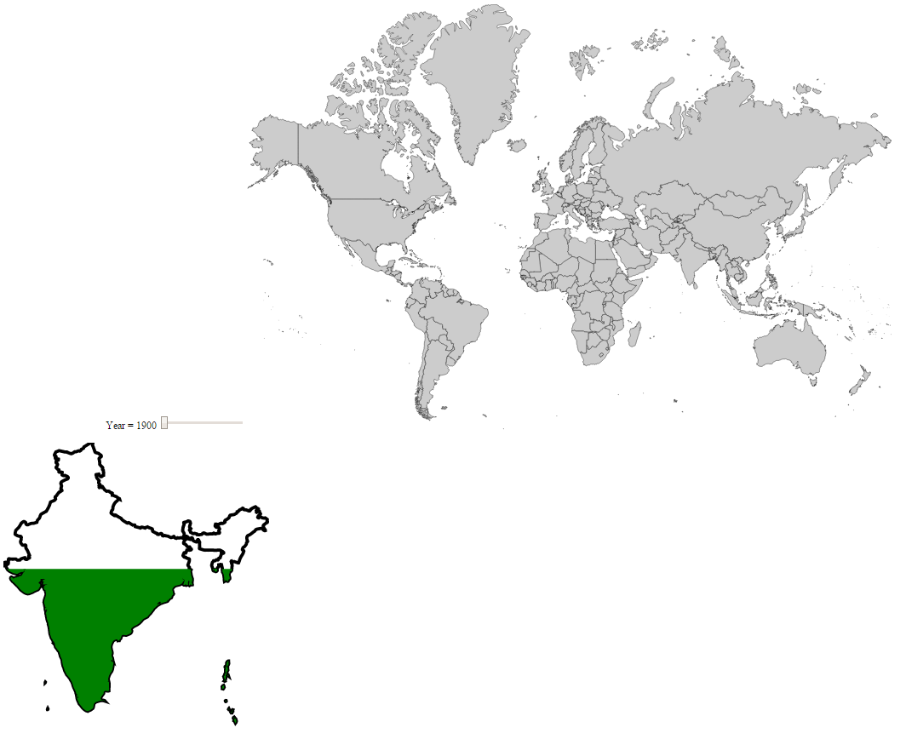
Use Case Implementation

Slide 19
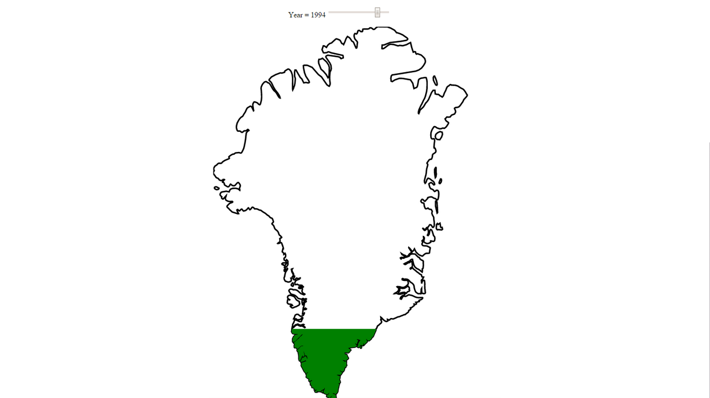
Use Case Implementation

Slide 20
Thank You

